Slide 1
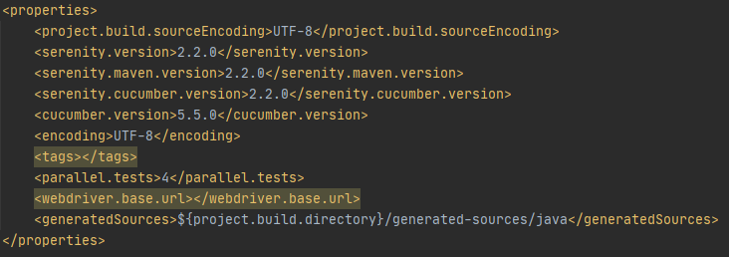
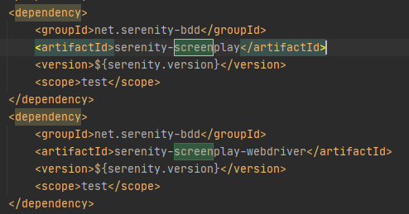
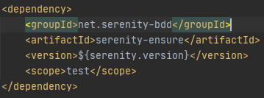
Serenity BDD Screenplay Maven POM
1. Screenplay
2. Screenplay -Web Drive
3. Serenity Fluent Wait

Slide 2
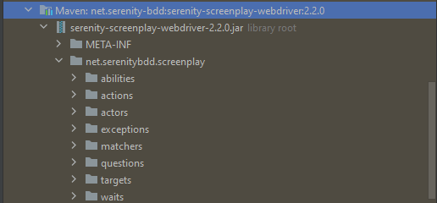
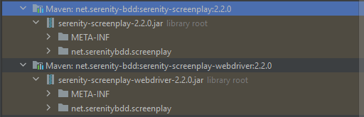
Serenity BDD Screenplay Lib Content
Note: Incase that these Lib are missing, Right click on POM.xml, selects Maven, select Reload Project.

Slide 3
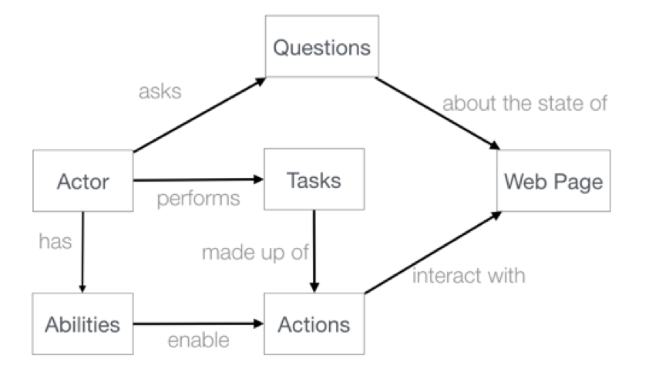
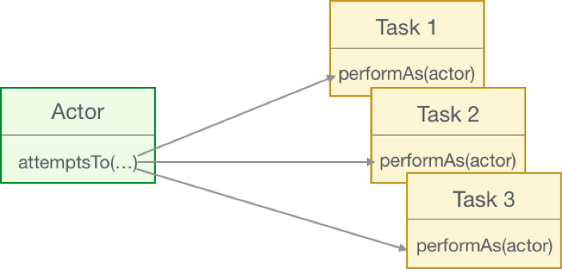
Serenity BDD Screenplay Pattern
Note: Testcase is a scenario where we prove that user can/can't able to do things.
Screenplay pattern is a way to prove that.

Slide 4
Serenity BDD Screenplay Pattern
Given: User is on the alert menu
When: S?he select Button A
Then: Popup B should show up
Tasks
Questions
Tasks
Actions
Actions
Tasks
Actions

Slide 5
Type | Example
Open a web page | Open.url("https://google.com")
Clicking on an element | Click.on(PageObject.Locator)
Typing value into fields | Enter.theValue("abcde").into(PageObject.Locator)
Hitting a key | Hit.the(Keys.ENTER).into(PageObject.Locator)
Working with dropdowns | SelectFromOptions.byVisibleText("Hanoi").from(PageObject.Locator)
Moving the mouse | MoveMouse.to(PageObject.Locator)
Javascript Clicks* | JavaScriptClick.on(PageObject.Locator)
Scrolling | Scroll.to(PageObject.Locator)
Switching Frames/Window | Switch.toFrame(2), Switch.toWindow(windowTitle)
Writing custom interaction class**
Type | Example
Chain interactions | Open.url("https://google.com").andThen( actions -> actions.doubleClick()
Screenplay Web Driver Interactions:
* Incase a normal webdriver click does not work, use this. ** Basically a combination of interactions .

Slide 6
Type | Example
Reading Text | Text.of(PageObject.Locator).viewedBy(actor).as<Type>()
Reading Values | Value.of(PageObject.Locator).viewedBy(actor).as<Type>()
Reading from drop down list | SelectedValue.of(PageObject.Locator).viewedBy(actor).as<Type>() SelectedVisibleTextValue.of(PageObject.Locator).viewedBy(actor).as<Type>()
Reading Atributes | Attribute.of(PageObject.Locator).named("abc").viewedBy(actor).as(<Type>) CSSValue.of(PageObject.Locator).named("abc").viewedBy(actor).as<Type>()
Checking UI State* | isVisible(), isNotVisible(), isCurrentlyVisible(), isNotCurrentlyVisible(),isEnabled(),isNotEnabled(), isCurrentlyEnabled(), isNotCurrentlyEnabled(), isPresent(), isNotPresent(), isSelected(), isNotSelected(), containsText(), containsOnlyText(), containsSelectOption(), hasValue() WebElementQuestion.the(TITLE),WebElementStateMatchers.isVisible() the(TITLE), isVisible() ** import static net.serenitybdd.screenplay.matchers.WebElementStateMatchers.*; import static net.serenitybdd.screenplay.questions.WebElementQuestion.the;
Type | Example
Performing Wait | WaitUntil.the(TITLE, isVisible()) WaitUntil.the(TITLE, isVisible()).forNoMoreThan(10).seconds()
Screenplay Web Driver Questions:
* Pick one out of them .**use static import to make the code more readable

Slide 7
Type | Example
Integer, long, float numbers | Ensure.that(age).isEqualTo(18) Ensure.that(age).isNotEqualTo(65) Ensure.that(age).isGreaterThan(18) Ensure.that(age).isGreaterThanOrEqualTo(20) Ensure.that(age).isLessThan(100) Ensure.that(age).isBetween(18,25) Ensure.that(age).isStrictlyBetween(20,25)
Double and float numbers | Ensure.that(creditScore).isCloseTo(9.81F, 0.01F)
Strings | Ensure.that(name).isEqualTo("Bill") Ensure.that(name).isNotEqualTo("Joe") Ensure.that(name).isGreaterThan("Alfred") * Ensure.that(name).isGreaterThanOrEqualTo("Al") * Ensure.that(name).isLessThan("Carrie") * Ensure.that(name).isBetween("Bill","Carrie") Ensure.that(name).isStrictlyBetween("Al",25)
Serenity Ensure:
* https://en.wikipedia.org/wiki/Lexicographic_order .

Slide 8
Type | Example
Assertions to check the String Contents | Ensure.that(colors).containsIgnoringCase("RED") Ensure.that("123").containsOnlyDigits() Ensure.that("abc123").containsOnlyLettersOrDigits() Ensure.that("abc").containsOnlyLetters() Ensure.that("Red Green").containsWhitespaces() Ensure.that(" ").containsOnlyWhitespaces() Ensure.that(colors).startsWith("Red") Ensure.that(colors).endsWith("Blue") Ensure.that(colors).matches("Red (.*) Blue") Ensure.that(colors).doesNotContain("cyan") Ensure.that(" ").isBlank() Ensure.that(colors).isNotBlank() Ensure.that("").isEmpty() Ensure.that(colors).isNotEmpty() Ensure.that("red").isInLowerCase() Ensure.that("RED").isInUpperCase() Ensure.that("Green").isSubstringOf(colors)
Serenity Ensure:
* https://en.wikipedia.org/wiki/Lexicographic_order .

Slide 9
Type | Example
Assertions to check the length of the string | Ensure.that("red").hasSize(3) Ensure.that("red").hasSizeGreaterThan(2) Ensure.that("red").hasSizeGreaterThanOrEqualTo(3) Ensure.that("red").hasSizeLessThan(4) Ensure.that("red").hasSizeLessThanOrEqualTo(3) Ensure.that("red").hasSizeBetween(1,5) Ensure.that(colors).hasLineCount(1)
Assertions using Lambda expressions, return true/false | String actualColor = "green"; Ensure.that(actualColor).matches("is an RGB color", color -> color.equals("red") || color.equals("blue") || color.equals("green"))
Negative assertions | Ensure.that(colors).not().contains("Cyan")
Working with dates and times | LocalTime tenInTheMorning = LocalTime.of(10,0); LocalTime twoInTheAfternoon = LocalTime.of(14,0); Ensure.that(tenInTheMorning).isBefore(twoInTheAfternoon) ---- LocalDate firstOfJanuary = LocalDate.of(2000,1,1); Ensure.that(firstOfJanuary).isDayOfWeek(DayOfWeek.SATURDAY)
Serenity Ensure:
* https://en.wikipedia.org/wiki/Lexicographic_order .

Slide 10
Type | Example
Assertions to check the length of the string | Ensure.that("red").hasSize(3) Ensure.that("red").hasSizeGreaterThan(2) Ensure.that("red").hasSizeGreaterThanOrEqualTo(3) Ensure.that("red").hasSizeLessThan(4) Ensure.that("red").hasSizeLessThanOrEqualTo(3) Ensure.that("red").hasSizeBetween(1,5) Ensure.that(colors).hasLineCount(1)
Assertions using Lambda expressions, return true/false | String actualColor = "green"; Ensure.that(actualColor).matches("is an RGB color", color -> color.equals("red") || color.equals("blue") || color.equals("green"))
Negative assertions | Ensure.that(colors).not().contains("Cyan")
Working with dates and times | LocalTime tenInTheMorning = LocalTime.of(10,0); LocalTime twoInTheAfternoon = LocalTime.of(14,0); Ensure.that(tenInTheMorning).isBefore(twoInTheAfternoon) ---- LocalDate firstOfJanuary = LocalDate.of(2000,1,1); Ensure.that(firstOfJanuary).isDayOfWeek(DayOfWeek.SATURDAY) isDayOfWeek(SATURDAY), isDayOfMonth(1), isInTheMonthOf(JANUARY), isTheYear(2000)
Serenity Ensure:
* https://en.wikipedia.org/wiki/Lexicographic_order .

Slide 11
Type | Example
Assertions about list equality and size | Ensure.that(list1).isEqualTo(list2) Ensure.that(list1).isEmpty() Ensure.that(list1).isNotEmpty() Ensure.that(list1).hasSize(3) Ensure.that(list1).hasSizeGreaterThan(2) Ensure.that(list1).hasSizeLessThan(4) Ensure.that(list1).hasSizeBetween(2,4) Ensure.that(list1).hasSameSize(list2)
Assertions about list contents | Ensure.that(colors).contains("red","blue") Ensure.that(colors).anyOf("red","pink") Ensure.that(colors).containsOnly("blue","green","red") Ensure.that(colors).containsExactly("red","blue","green") Ensure.that(colors).containsExactly("red","blue","green") Ensure.that(colors).doesNotContain("pink") Ensure.that(allColors).containsElementsFrom(colors) Ensure.that(colors).containsAnyElementsOf(redAndPink) Ensure.that(colors).containsExactlyElementsOf(sameColors) Ensure.that(colors).isASubsetOf(allColors) Ensure.that(colors).doesNotHaveDuplicates() Ensure.that(colors).startsWith("red", "green") Ensure.that(allColors).startsWithElementsFrom(colors) Ensure.that(colors).endsWith("green","blue") Ensure.that(allColors).endWithElementsFrom(lastColors)

Slide 12
Type | Example
Matching list elements with Java 8 Lambdas | List<String> colors = ImmutableList.of("blue", "cyan", "pink"); aster.attemptsTo( Ensure.that(colors).allMatch("4 characters long", it -> it.length() == 4) ); allMatch, anyMatch, noneMatch, atLeast
Using Named Expectations | aster.attemptsTo( Ensure.that(colors).anyMatch(IS_A_PRIMARY_COLOR) ); private static final NamedExpectation<String> IS_A_PRIMARY_COLOR = new NamedExpectation<>("is a primary color", color -> (color.equals("red")) || (color.equals("green")) || (color.equals("blue")));

Slide 13
Type | Example
Web element assertions | Ensure.that(PageObject.Locator).isDisplayed() Ensure.that(PageObject.Locator).isDisabled() Ensure.that(PageObject.Locator).isEnabled()
Checking text content and field values | Ensure.that(PageObject.Locator).value().isEqualTo("Joe") Ensure.that(PageObject.Locator).text().isNotEmpty() Ensure.that(PageObject.Locator).textContent().isNotEmpty() Ensure.that(PageObject.Locator).attribute("title").isEqualTo("First name") Ensure.that(PageObject.Locator).selectedValue().isEqualTo("green") Ensure.that(PageObject.Locator).selectedVisibleText().isEqualTo("Green") Ensure.that(PageObject.Locator).hasCssClass("color-list") Ensure.that(PageObject.Locator*).containsElements(".result-details")
Converting values to different types | Ensure.that(ITEM_COUNT).value().asAnInteger().isEqualTo(2) Ensure.that(TOTAL_COST).value().asADouble().isEqualTo(99.99d) Ensure.that(TOTAL_COST).value().asAFloat().isCloseTo(99.99f,0.01f) Ensure.that(TOTAL_COST).value().asABigDecimal().isEqualTo(new BigDecimal("99.99")) Ensure.that(CURRENT_DATE).value().asADate().isEqualTo(expectedLocalDate) Ensure.that(CURRENT_TIME).value().asATime().isEqualTo(expectedLocalTime) Ensure.that(SOME_FLAG).value().asABoolean().isTrue()
Serenity Ensure Web Elements:
*List.

Slide 14
Type | Example
Making assertions about collections of web elements | Ensure.thatTheSetOf(RESULTS).allMatch(isDisplayed()) Ensure.thatTheSetOf(RESULTS).noneMatch(isNotDisplayed()) Ensure.thatTheSetOf(INPUT_FIELDS).atLeast(1, isDisabled()) Ensure.thatTheSetOf(INPUT_FIELDS).atLeast(1, isNotDisabled()) Ensure.thatTheSetOf(INPUT_FIELDS).atLeast(1, isEnabled()) Ensure.thatTheSetOf(INPUT_FIELDS).atLeast(1, isNotEnabled()) Ensure.thatTheSetOf(RESULTS).noMoreThan(1, hasCssClass("selected")) Ensure.thatTheSetOf(RESULTS).anyMatch(hasValue("red")) Ensure.thatTheSetOf(RESULTS).anyMatch(containsText("Red")) Ensure.thatTheSetOf(RESULTS).anyMatch(containsOnlyText("Red Car")) Ensure.thatTheSetOf(RESULTS).anyMatch(containsElementsLocatedBy(".model"))
Waiting for elements and defining timeouts | Target SLOW_FIELD = Target.the("Slow field") .locatedBy("#slow") .waitingForNoMoreThan(Duration.ofSeconds(5)) aster.attemptsTo( Ensure.that(SLOW_FIELD .waitingForNoMoreThan(Duration.ofSeconds(10))) .value() .isEqualTo("Marseille") );
Serenity Ensure Web Elements:
*Custom Implicit and explicit wait.

Slide 15
Type | Example
Making assertions about the current page | Ensure.thatTheCurrentPage().title().isEqualTo("Some Title")
Reporting and hiding Ensure steps | aster.attemptsTo( Ensure.that(ElementLocated.by(PageObject.Locator)) .silently() .isDisplayed() );
Serenity Ensure Web Elements:
.

